Slide 1
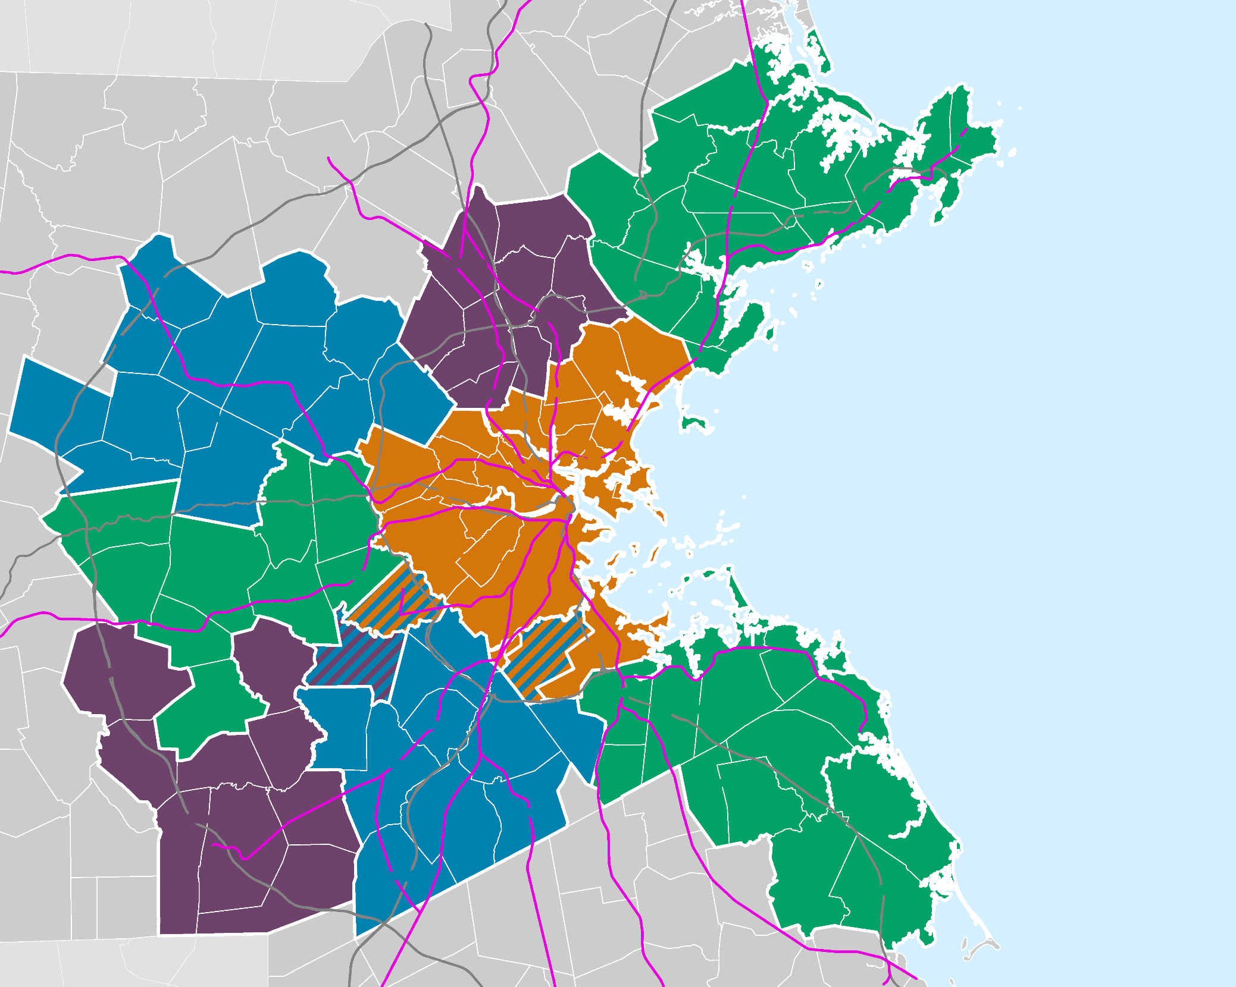
METROPOLITAN AREA PLANNING COUNCIL
Inflation Reduction Act
December 2022

Slide 2
IRA Overview
Signed by President Biden on August 16, 2022
Projected to reduce the federal deficit by $300 billion by 2031
Inflation Reduction Act| Metropolitan Area Planning Council | December 2022

Slide 3
IRA Overview
IRA creates, extends, and expands clean energy and climate resilience programs, access to health care, and tax provisions
Programs are moving through various federal and state departments
Some programs will begin in early 2023, others are currently in comment period and are still creating the regulations
IRA includes
Tax credits (or direct pay) for local, government, non-profit, private entities
Individual tax credits
Grant programs
Inflation Reduction Act| Metropolitan Area Planning Council | December 2022

Slide 4
Healthcare
No cost for all CDC recommended vaccines provided to Medicare beneficiaries
Caps the cost of prescription drugs for individuals on Medicare
Extends the broadened eligibility for ACA health insurance subsidies to individuals with incomes over 400 % of the federal poverty line through FY 2025.
Places up to a 95% excise tax penalty on pharmaceutical manufacturers as a penalty for non-compliance in negotiating drug prices for Medicaid
Inflation Reduction Act| Metropolitan Area Planning Council | December 2022

Slide 5
Tax Provisions
Includes an additional $80 billion for the IRS across 10 years to address the “tax gap”
this is estimated to raise $204 billion
New 1% tax on corporate stock buybacks
New 15% corporate alternative minimum tax for corporations with profits over $1 billion
Inflation Reduction Act| Metropolitan Area Planning Council | November 2022

Slide 6
Climate Overview
$369 billion for clean energy and climate provisions
Estimated to cut US green house gas emissions by 40% by 2030
Inflation Reduction Act| Metropolitan Area Planning Council | December 2022

Slide 7
Tax Credit Updates in the IRA
IRA also allows for direct pay in lieu of certain tax credits
Direct pay is limited to certain non-taxable entities (2023-2033)
Removes the need to rely on outside financing
The Treasury Department has not announced the process to elect for direct pay
IRA incorporates additional incentives:
Paying wages at prevailing rates and providing apprenticeship programs
The treasury just released the guidelines for what these requirements mean
Projects in low-income communities, former energy communities
Meeting domestic content threshold
Inflation Reduction Act| Metropolitan Area Planning Council | December 2022

Slide 8
Pollution
$27 billion Greenhouse Gas Reduction Fund*
Provides grants to mobilize financing and leverage private capital for clean energy and climate projects that reduce greenhouse gas emissions
Can be used to fund a state Climate Bank
$5 billion Climate Pollution Reduction Grants*
Inflation Reduction Act| Metropolitan Area Planning Council | November 2022

Slide 9
Transportation
$1.9 billion to the USDOT Federal Highway Administration to administer the new, competitive Neighborhood Access and Equity Grant Program
Improve walkability, safety, affordable transportation
$1 billion for Heavy Duty Vehicle Program* to award grants and rebates to state and local governments for up to 100 percent of the costs of:
Replacing a heavy-duty vehicle, such as a bus or garbage truck, with a zero-emission vehicle
Purchasing, installing, operating and maintaining the infrastructure needed to charge, fuel or maintain zero-emission vehicles
Workforce development and training to support the maintenance, charging, fueling and operation of zero-emission vehicles
Planning and technical activities to support the adoption and deployment of zero-emission vehicles
Inflation Reduction Act| Metropolitan Area Planning Council | November 2022

Slide 10
Transportation
$3 billion for a Port Pollution Program* at EPA to award grants and rebates to state and local governments with jurisdiction over a port or port authority:
Purchasing or installing zero-emission port equipment or technology
Planning and permitting related to the purchase or installation of zero-emission port equipment or technology
Developing qualified climate action plans
Inflation Reduction Act| Metropolitan Area Planning Council | November 2022

Slide 11
Buildings
$9 billion DoE Energy Consumer Rebate Programs
Will award grants to state energy offices (MA EEA) to develop and implement a high-efficiency electric home rebate program for low- or moderate-income households or owners of multifamily buildings where at least 50 percent of the residents are low- or moderate-income
High-Energy Electric Home Program *
Home Energy Performance-Based, Whole-House Rebates program*
$1 billion to DOE to award grants to states and local governments to adopt the latest building energy or zero-energy codes for residential and commercial buildings
$1 billion for U.S. Department of Housing and Urban Development (HUD) to provide loans and grants to fund energy and water efficiency projects in affordable housing
Inflation Reduction Act| Metropolitan Area Planning Council | November 2022

Slide 12
Clean Energy Development
Expansion and Extension of Tax Credits for Clean Energy Development
Production Tax Credit and the Investment Tax Credit
Can be used to help finance renewable energy projects
Local governments with municipal utilities that finance a clean energy capital project, such as a solar array, will be eligible for the direct pay option for installing such a project in the community
Inflation Reduction Act| Metropolitan Area Planning Council | December 2022

Slide 13
Individual Tax Credits
Energy Efficiency Improvements and residential energy property expenditures (through 2032)
Raises dollar limit on “clean vehicle credit” for vehicles purchased beginning in 2023 (through 2032)
Used vehicle credit for vehicles purchased after 2022*
Inflation Reduction Act| Metropolitan Area Planning Council | December 2022

Slide 14
Questions?
Georgia Barlow
gbarlow@mapc.org
(207) 351-7502
Inflation Reduction Act| Metropolitan Area Planning Council | December 2022

